Slide 1
Sw development 2014
Etisalat Egypt – Mohamed Kashef

Slide 2
agenda
Service Delivery tools Portal
Why in-house development
2014 Development Highlights
Automated Outage Report
Fault Management Assistance System
Large Node Monitoring System
E2E network audits
Achievements
Hours saved in Etisalat NOSC
Tools list
Future Plans

Slide 3
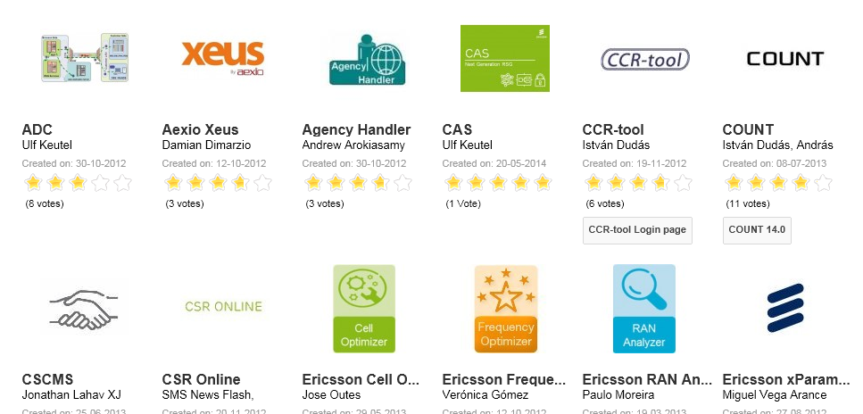
Service Delivery tools Portal
SD Tools: 1051 tools available
http://toolsportal.internal.ericsson.com/?id=17&task=category&option=com_k2&view=itemlist&filter_order=&filter_order_Dir=&display=brief&limitstart=0&limit=12&viewcache=01&domain=&process=&area=&type=&tag=&globallyrecommended=&notrecommended=&usingOrganization=0&developingOrganization=0&savedFilter=0&deleteFilter=0&searchword

Slide 4
Why in-house development
Filling currently existing automation gaps
Extending the functionality of currently available tools
Tailoring applications to realize the full potential of integrated products
Complementary applications to increase the level of automation within the business

Slide 5
Automated Outage Report
Legacy Outage Reporting
Tracking and reporting all RAN outages across the network for multiple vendors
Analyzing and tracking the cause of each outage through alarm analysis, topology correlation or on site analysis by FM
Sending hourly notification SMS with overall network health, major reasons for network outages and any major network incidents
Tasks utilize one front office engineer for at least 6 hours per shift (12 hours per day) working on a manual basis

Slide 6
Automated Outage Report
Multi-vendor 2G/3G Automated Outage Reporting System
A reporting system for RAN Site/Cell unplanned outages in the network
Integrated with OSS systems (Ericsson OSS-RC/ZTE NetNumen)
Web interface for FM, access and retention teams to track on-site analysis results and site access status
Automated topology-based outage correlation utilizing dynamic transmission configuration data
Automated root cause analysis module based on BTS information
Executive dashboards to provide insight on overall network and FM performance
Operational assistance dashboards to track recurrently flapping cells/sites

Slide 7
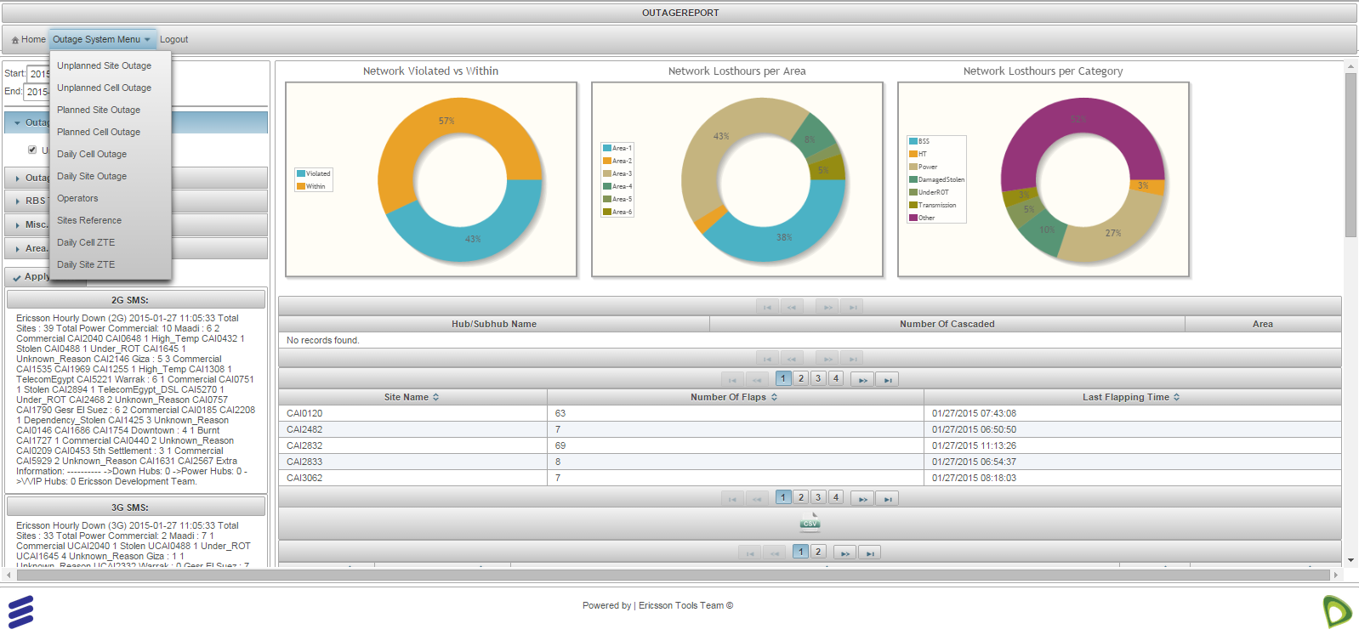
Automated Outage Report

Slide 8
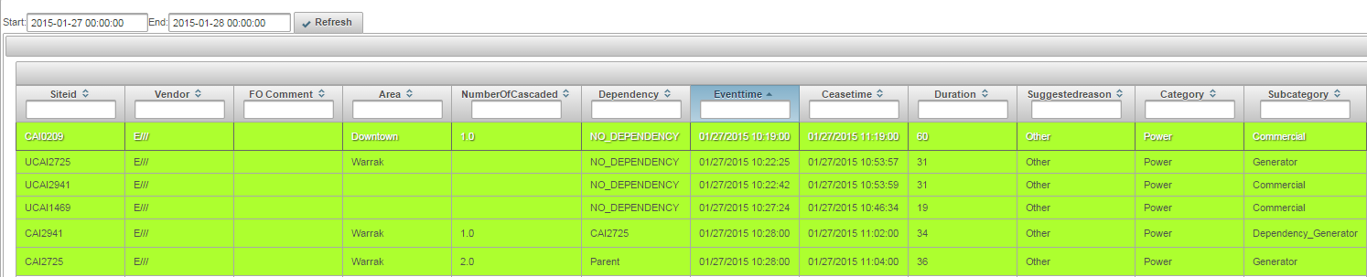
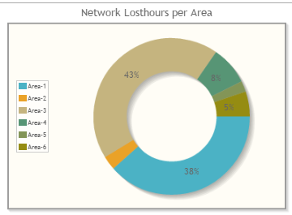
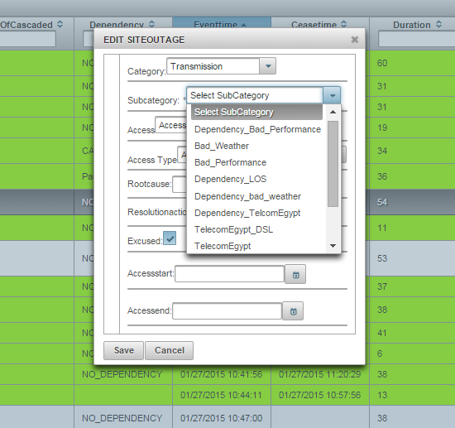
Automated Outage Report

Slide 9
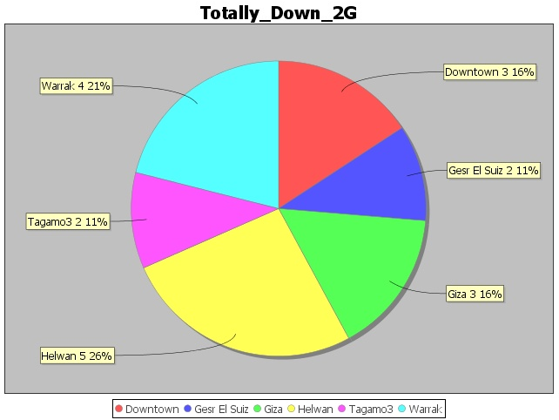
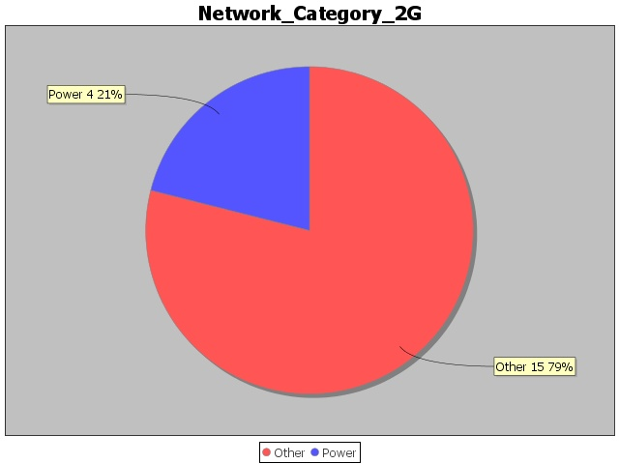
Automated Outage Report
Site | BSC | Down-Cells | Total-Cells | Site-Status | Alarms | Suggested Reason | Area
CAI2977 | CBX23 | G A | 6 | Partially Down | No Alarms Found | Other" | Helwan
CAI2586 | CBX24 | H G F E D C B A | 8 | Totally Down | 2015-01-19 16:21:00 - 2015-01-19 16:21:00 - EMERSON AIR CONDITION ALARM 2015-01-19 19:46:00 - MAJOR POWER ALARM(ONE PSU) EMERSON DOOR OPEN EMERSON AIR CONDITION ALARM 2015-01-19 19:46:00 - CRITICAL POWER ALARM(AC,DC,2PSU) 2015-01-19 16:21:00 - MAJOR POWER ALARM(ONE PSU) | Power" | Tagamo3

Slide 10
Automated Outage Report
Multi-vendor 2G/3G Automated Outage Reporting System
Projected savings of more than 12,000 man hours per year (direct impact)
Increasing reporting accuracy, speed and quality
Enhancing network insight and assisting in network planning/fault management
Contributing to penalty avoidance/reduction

Slide 11
Fault Management Assistance System
Fault Management Assistance System (Mubasher)
SMS alarm relay system for FM teams
System communicates over SMS with FM engineers to receive problematic sites from FM and relay currently active alarms
Multi-vendor support (Ericsson OSS-RC/ZTE NetNumen)
Integration with in-house system to track historical outages
Supports alarm beautification/enrichment
Response time < 2 seconds
Handling more than 15,000 requests per day
User base exceeding 200 users

Slide 12
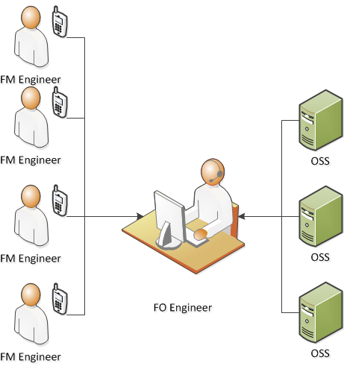
Fault Management Assistance System
Maximum 5 requests per minute
Average response time ~ 60 seconds per request

Slide 13
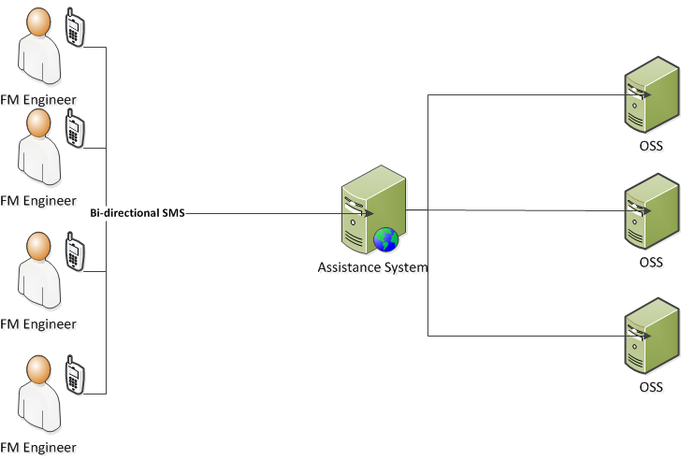
Fault Management Assistance System
Currently handling 20 requests per minute (no theoretical limit)
Average response time ~1 second

Slide 14
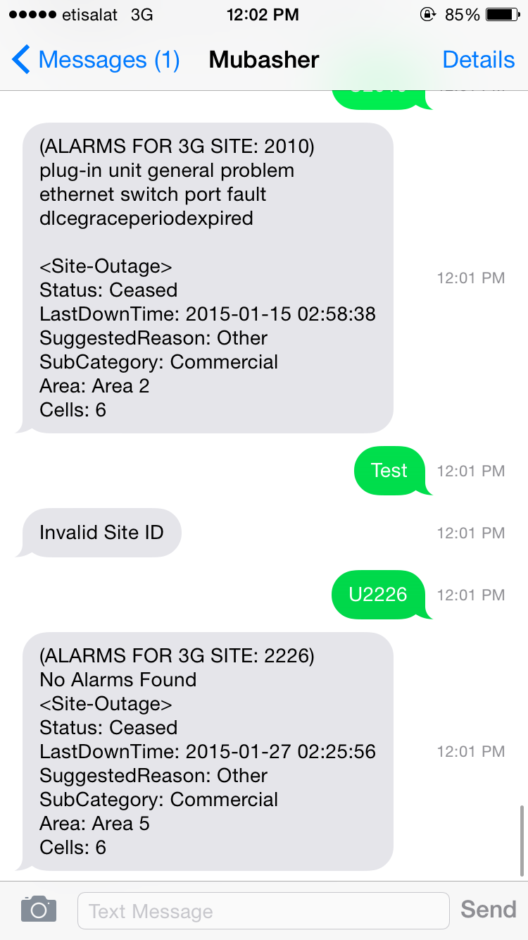
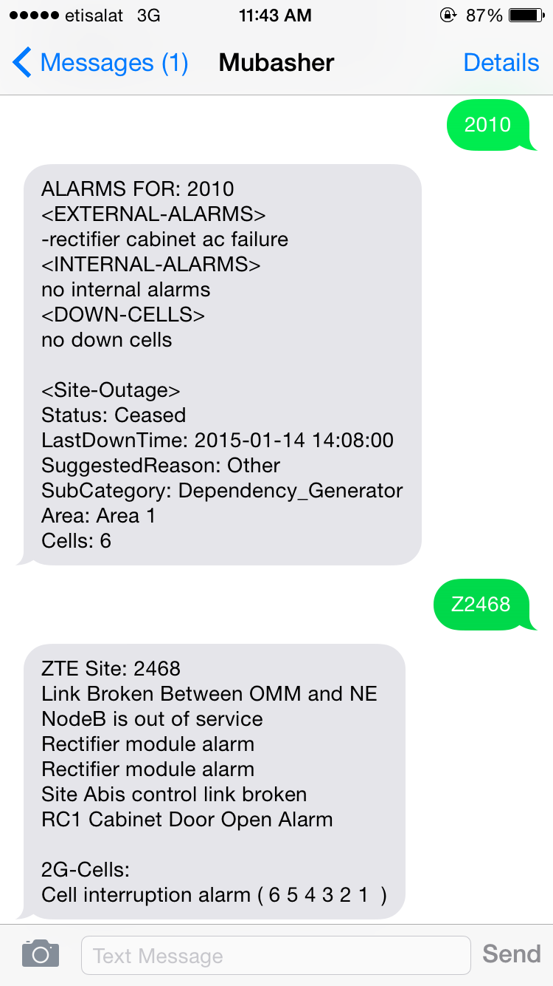
Fault Management Assistance System

Slide 15
Fault Management Assistance System
No more discarded requests due to heavy operator load
No more request backlog due to instantaneous response
Improved delivery quality by directing FM engineers in a timely and more accurate manner
No room for error or misinterpretation between FM/FO
Saved costs for both FM and FO through reduction of overtime and eliminating FM idle time
Approximated savings of 5,000 man hours

Slide 16
Large Node Monitoring System
Large Node Monitoring System
Multi-vendor monitoring system (Ericsson/ZTE)
Monitoring with 15 min granularity (dependent upon KPI generation granularity) for early detection of any KPI degradation
Customized threshold for traffic deviation
E-mail and SMS based notifications for various user groups and escalations

Slide 17
E2E Audits
Various E2E Audits
Multi-vendor (Ericsson/ZTE/Huawei)
Multiple E2E audits on Network configurations to detect
RAN Cell Definition
FNR/HLR/AUC discrepancies
QoS on Transmission Mini Links.
Multiple parameters on MSCs
Reports running on top of Ontology 360 (Logical Inventory Product)

Slide 18
Achievements
Projected savings of over 30,000 man hours per calendar year

Slide 19
Achievements
Projected savings per month

Slide 20
Tools list
Project Name | MS Team | Type of Tool | Saved Hours | Granularity | Factor | Saved Hours per year
3G ENIQ Alternative | FO | Stand-alone | 0.25 | Hourly | 8760 | 2190
E-mail notification system | FM | Stand-alone | 4 | Daily | 365 | 1460
Outage Reporting System | FO | Stand-alone | 4 | Daily | 365 | 1460
E2E Inner Cell Definition Audits | E2E | Extension | 96 | Monthly | 12 | 1152
Outage Report Auto-analysis | FM | Extension | 3 | Daily | 365 | 1095
Anritsu Self-Health Check | Core | Stand-alone | 2 | Daily | 365 | 730
Automated daily Helpdesk dashboards | HD | Customization | 2 | Daily | 365 | 730
Daily Power Alarm Analysis | FO | Stand-alone | 2 | Daily | 365 | 730
Outage Reporting System Phase 2 | FO | Customization | 2 | daily | 365 | 730
MTTR per team report for multi-owner TT's | HD | Extension | 2 | daily | 365 | 730
Outage report 3G alarm aggregation | FO | Extension | 2 | Daily | 365 | 730
Change Management System | FO | Stand-alone | 2 | Daily | 365 | 730
Mubasher [2G] - Ericsson | FM | Stand-alone | 0.5 | N/A | N/A | 5000
Customized HD Reports and Exports | HD | Customization | 1.5 | Daily | 550 | 1100
HLR - HLR Audits | E2E | Extension | 96 | 3 Months | 4 | 384
HLR - AUC Audits | E2E | Extension | 96 | 3 Months | 4 | 384
AUC - AUC Audits | E2E | Extension | 96 | 3 Months | 4 | 384
FNR - HLR Audits | E2E | Extension | 96 | 3 Months | 4 | 384
FNR - FNR Audits | E2E | Extension | 96 | 3 Months | 4 | 384
APN IP Pool [Phase 2] | IPBB | Extension | 96 | 3 Months | 4 | 384
TX QOS Audit | TX | Extension | 96 | 3 Months | 4 | 384
LAC & RAC audit | Core | Extension | 96 | 3 Months | 4 | 384
Core node parameter and consistency audit | Core | Extension | 96 | 3 months | 4 | 384
BSC/RNC Definition Audit | Core | Extension | 96 | 3 months | 4 | 384
E2E Core Audit tools phase 2 | E2E | Extension | 96 | 3 Months | 4 | 384
Cascaded Sites Report | FO | Extension | 1 | daily | 365 | 365
Outage System Auditing Tool | FO | Extension | 1 | daily | 365 | 365
Repetitive Cell Outage Analyzer | E2E | Stand-alone | 1 | Daily | 365 | 365

Slide 21
Future plans
RMEA Tools repository on ERICOLL and BUGS tools portal
CU cross utilization and tool re-use
RMEA Tools virtual team

